Slide 1
Probability & Probability Distributions

Slide 2
Introduction to Probability
Classic Model:
Number of outcomes in which the event occurs
=
Total Number of possible outcomes of an experiment
Relative Frequency of occurrence:
=
Number of times an event occurred
Total Number of opportunities for an event to occur

Slide 3
Introduction to Probability
Venn Diagram:
Event A: Probability of getting 1 or 4 in the roll of a dice.
A
2
3
6
1
4
5

Slide 4
Introduction to Probability
Venn Diagram:
Event A: Probability of getting 1 or 4 in the roll of a dice.
Event C: Probability of getting 2,3,5 or 6
A
C
2
3
6
1
4
5

Slide 5
Introduction to Probability
Venn Diagram:
Event A: Probability of getting 1 or 4 in the roll of a dice.
Event C: Probability of getting 2,3,5 or 6
Mutually Exclusive Events: When two events cannot occur at the same time
A
C
2
3
6
1
4
5

Slide 6
Introduction to Probability
Venn Diagram:
Event A: Probability of getting 1 or 4 in the roll of a dice.
Event C: Probability of getting 1,2,3,5 or 6
A
C
2
3
6
1
4
5

Slide 7
Introduction to Probability
Union:
Probability that events A or C occur
P(A U C)
{1,2,3,4,5,6}
Intersection:
Probability that events A and C occur
P(A C)
U
A
C
2
3
6
1
4
5

Slide 8
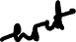


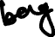
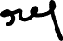

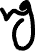
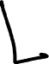


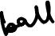

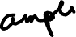
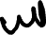
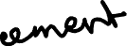


Introduction to Probability
Mutually Exclusive Events:
When two events cannot occur at the same time
Independent Events:
The occurrence of Event A does not change the probability of event B
Dependent Events:
The occurrence of Event A changes the probability of event B
Complementary Events:
The probability that Event A will NOT occur is denoted by P(A’)

Slide 9

Mutually Exclusive Events

Slide 10

Independent Events

Slide 11

Dependent Events

Slide 12

Complements of An Event

Slide 13
Rule of Multiplication
The probability that Events A and B both occur=
Probability that Events A occurs
X
Probability that Events B occurs, given that A has occurred
Probability that events A and B occur
P(A B) = P(A) P(B|A)
U
What is the probability that if you flip two coins, what will be the probability of getting head in both of these flipping of coins?
In two rolls of dice, what is the probability of getting 6 in both?
There are 10 candies in a plate(5 green, 2 Yellow, 2 orange and 1 Red). If I pick 2 random ones, what is the probability of getting both yellow?

Slide 14
Rule of Addition
The probability that Events A or B occurs =
₊
₋
Probability that Events A occurs
Probability that Events B occurs
Probability that both Events A and B occur
P(A B) = P(A) + P(B) - P(A B)
U
U
A
B
2
6
1
4
3
5

Slide 15
Factorial
Factorial of a non negative integer n, denoted by n!, is the product of all positive integers less than or equal to n
5!= 5 x 4 x 3 x 2 x 1
1!= 1
0!= 1

Slide 16
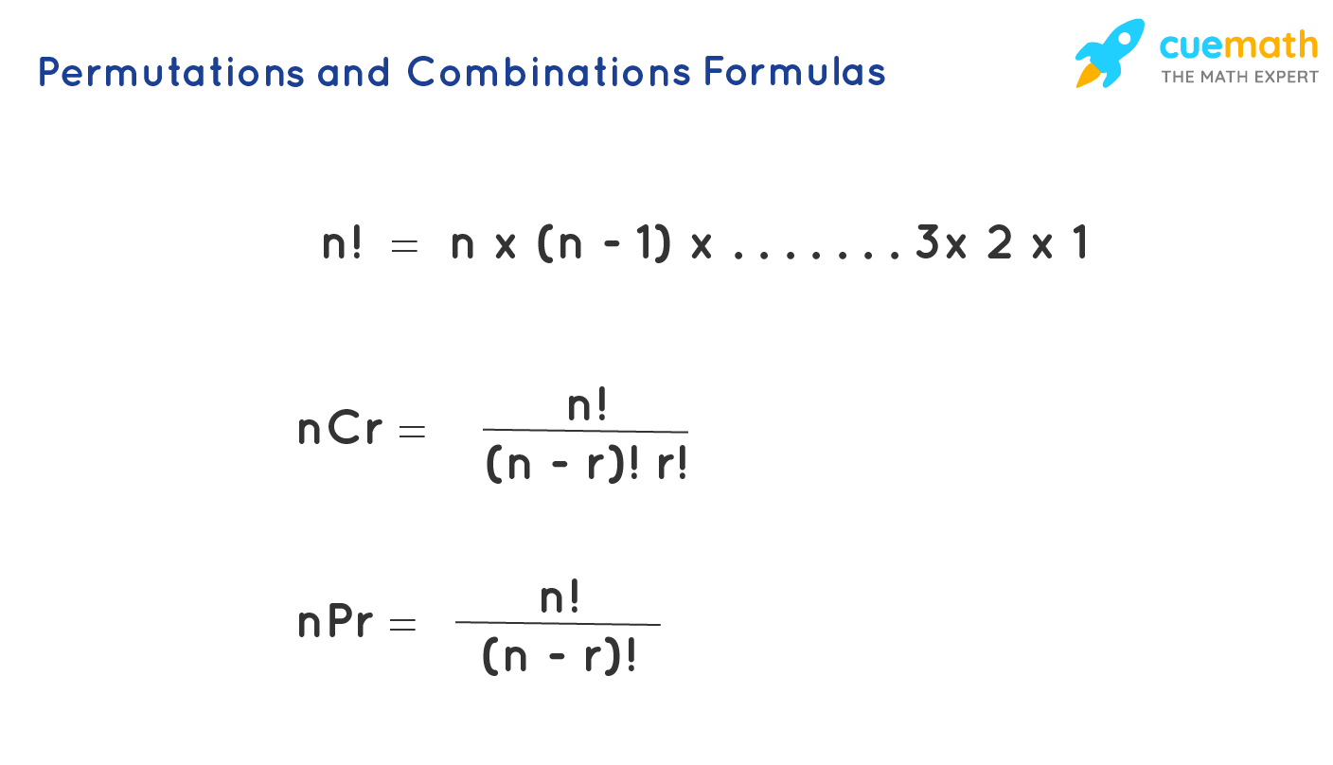
Permutation and Combination
Permutation: A set of objects in which position (or order) is important. E.g. Lock
Combination: A set of objects in which position (or order) is NOT important, E.g. Select 3 people

Slide 17

Permutation and Combination
Permutation with repetition:
In case of a lock, total permutations are
10 x 10 x 10 x 10 =10,000
r
n

Slide 18

Permutation and Combination
Permutation without repetition:
In how many ways we can select 3 players out of 5. The first selected becomes the captain, second the vice captain and third the treasurer.
5
5!
60
=
=
5 x 4 x 3
P
=
3
(5 - 3)!

Slide 19
Permutation and Combination
Combination without repetition:
In how many ways we can select 3 players out of 5.
5
5!
=
=
10
C
3
(5 - 3)! x 3!

Slide 20
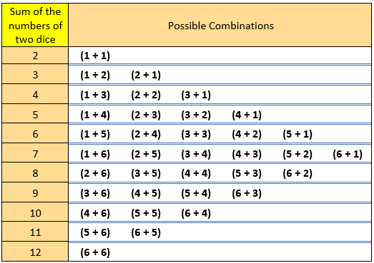
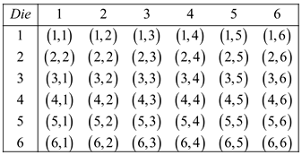
Sample Probability Solution
If two dice are rolled, what is the probability of getting the sum of numbers greater than 7?

Slide 21
If two dice are rolled, what is the probability of getting the sum of numbers greater than 7?
Shown in python as well

Slide 22
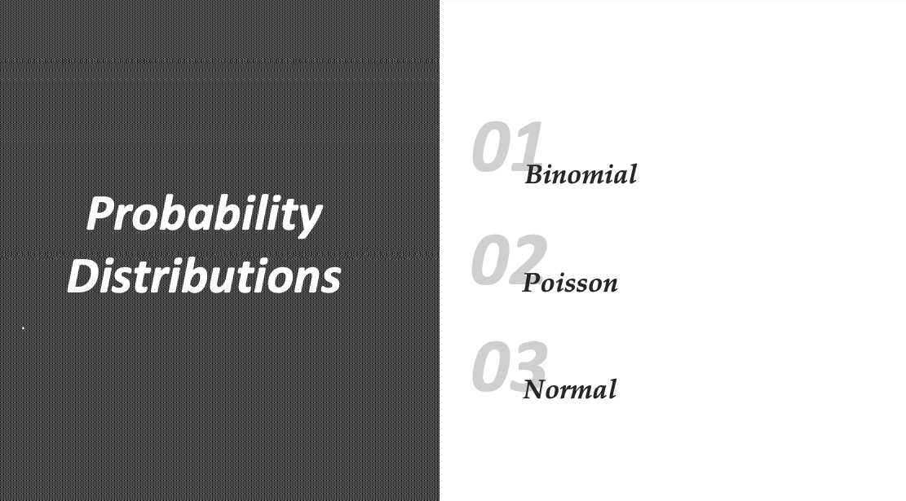
Probability Distribution
Discrete Variable

Slide 23
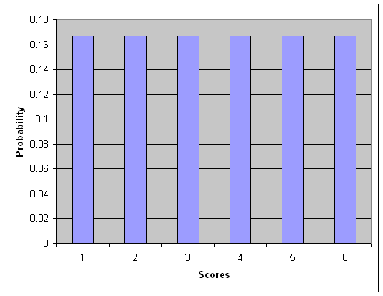
Probability Distribution
Rolling a Die

Slide 24
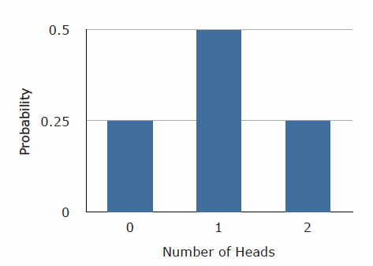
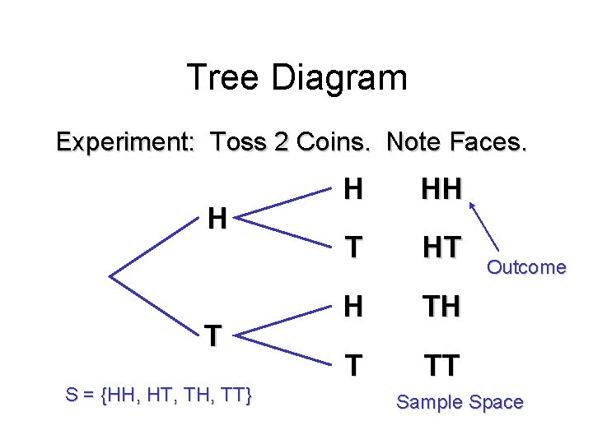
Probability Distribution
Flipping 2 coins

Slide 25
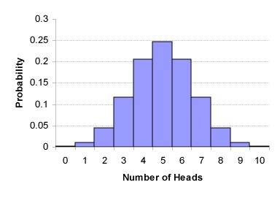
Probability Distribution
Flipping 10 coins

Slide 26
Probability Distribution
What we learnt?
Sum of all area would be 1
Next
Discrete(count) vs Continuous(measurement)

Slide 27
Probability Distribution
What is Binomial Distribution?
A binomial distribution has the following properties:
The experiment consists of n repeated trials.
Each trial can result in just two possible outcomes. We call one of these outcomes a success and the other, a failure.
The probability of success, denoted by p, is the same on every trial.
The trials are independent, that is, the outcome on one trial doesn’t affect the outcome on other trials.

Slide 28
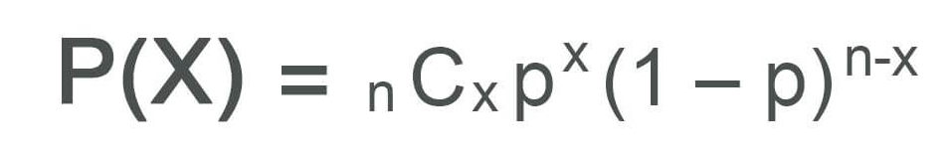
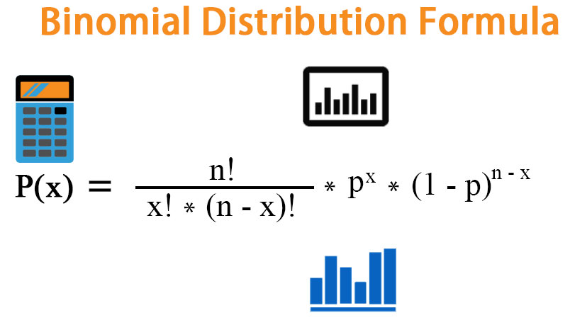
Binomial Distribution
X: The number of successes that result from the binomial experiment.
N: The number of trials in the binomial experiment.
P: The probability of success on an individual trial.
P(x): Binomial probability – This denotes the prob of getting x success i.e; the probability that an n-trial binomial experiment results in exactly x successes, when the probability of success on an individual trial is p and independent of the previous trial

Slide 29

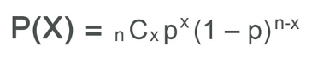
Binomial Distribution
If you flip a coin 4 times, what is the probability of getting 1 head?
N= repeat experiments or trials
X= Number of success success
P= prob of success in each trial

Slide 30
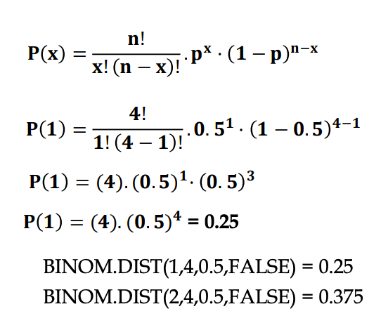
Binomial Distribution
If you flip a coin 4 times, what is the probability of getting 1 head?

Slide 31
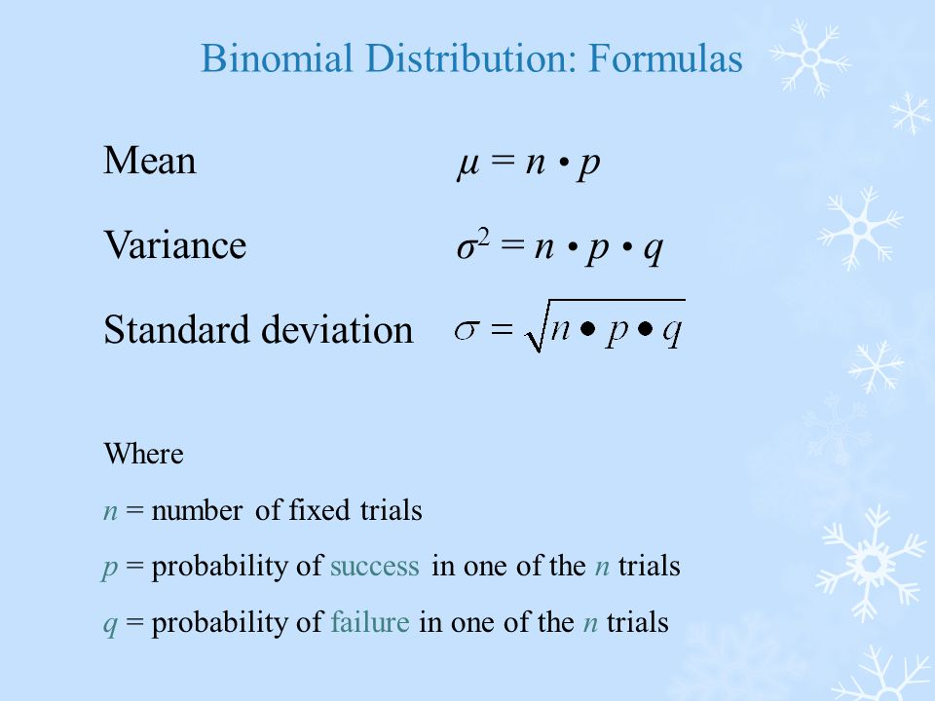
Binomial Distribution
If you flip a coin 4 times and the probability of getting a head is 0.5 then n=4 and p=0.5
Then Mean= 4 x 0.5 = 2
If you flip a coin 4 times, then on average you will get 2 heads if you keep repeating the experiment.
That would be the mean of the distribution

Slide 32
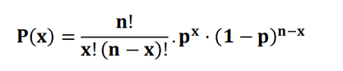
Binomial Distribution
1. A manufacturer has 12% defects rate in production. The buyer decides to test 20 random pieces and will accept the supplier if there are two or less defectives. What is the probability of getting accepted?
2. A binomial experiment has 30 trials with a probability of success of 0.25 on each trial. What is the mean of the distribution?

Slide 33
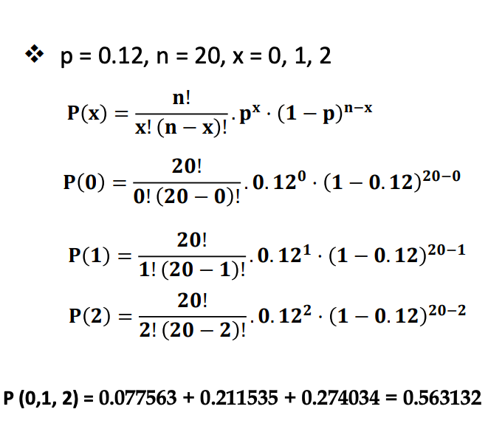
Solution (1)
1. A manufacturer has 12% defects rate in production. The buyer decides to test 20 random pieces and will accept the supplier if there are two or less defectives. What is the probability of getting accepted?

Slide 34
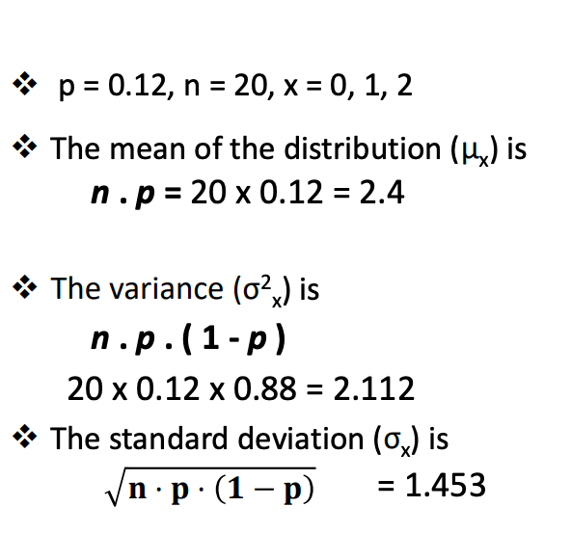
Solution (1)

Slide 35
Solution (2)
It is n.p or 30x0.25 = 7.5
Var: n*p*q=30*0.25*0.75=5.625

Slide 36
Poisson Distribution

Slide 37
Binomial vs Poisson Distribution
Similarities
Both are for discrete distribution
Both measures the number of successes
Differences
In Poisson distribution the possibilities of success are infinite.
On the contrary, in binom dist, the number of head while flipping the coin 10 times can max be 10 and min be 0 but cannot be more than 10.
E.g of poisson distribution are People waiting in Queue, No. of accidents in a city every hour. So, here the possibilities are unlimited

Slide 38
Poisson Distribution
Poisson Distribution has the following properties:
The experiment results in outcomes that can be classified as successes or failures.
The average number of successes(u) that occurs in a specified region is known.
Outcomes are random. The occurrence of one outcome does not influence the chance of another outcome of interest.
The outcomes of interest are rare relative to the possible outcomes.
Example: Road accidents / queue at the counter.

Slide 39
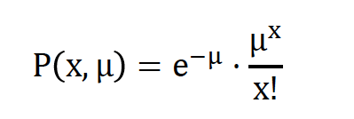
Poisson Distribution
Don’t remember
e: A constant equal to approximately 2.71828.(e, actually is the base of the natural logarithm system)
u: The mean number of successes that occur in a specified region.
X: The actual number of successes/accident that occur in a specified region.
P(x, u): The Poisson probability that exactly X success occurs in a poison experiment. When the mean number of success is u.

Slide 40
Poisson Distribution, an example
On a booking counter on average 3.6 people come every 10 minutes on weekends. what is the probability of getting 7 people in 10 minutes?
X=7
U=3.6
P(X,U)=0.0424

Slide 41
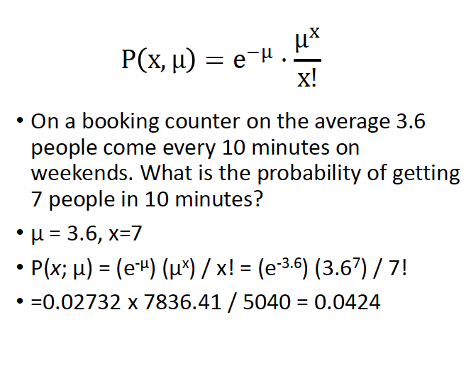
Note: as the average people comes queue is given with a unit of 10 min and the interested prob number is also asked in 10 min we didn’t have to make a lot of changes

Slide 42

Poisson Distribution, an example
The mean of Poisson distribution is u.
Variance is also u.
Interesting right !!!!! Both mean and variance are same in case of Poisson distribution

Slide 43
Normal Distribution

Slide 44
Normal Distribution
Why Normal Distribution?
Discrete vs Continuous Data
Normal Distribution is also known as Gaussian distribution?

Slide 45
Normal Distribution
Symmetrically distributed
Long Tails / Bell Shaped
Mean, Mode and Median are same if it is symmetrical
Two factors define the shape of the curve:
Mean
Standard Deviation
Is a skewed distribution a normal distribution????

Slide 46
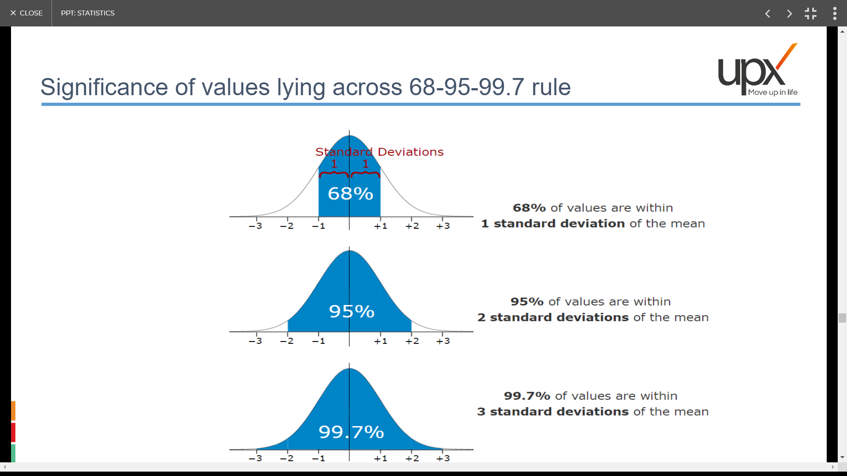
Significance of Values Lying Across 68-95-99.7 Rule

Slide 47
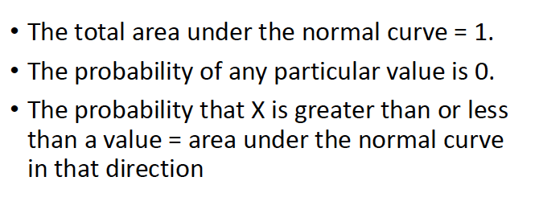
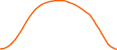




Properties of Normal Distribution

Slide 48
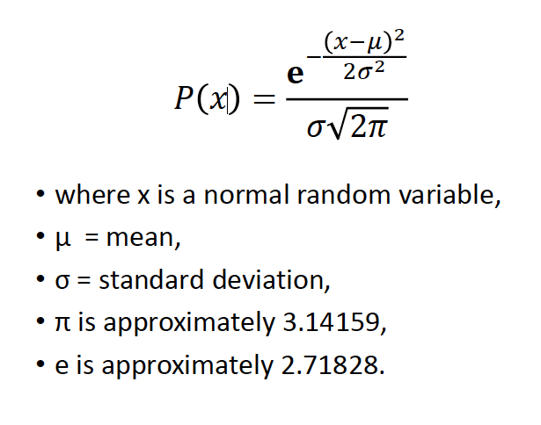
Normal Distribution
No need to learn

